Slide 1
Continuous Wave Spectroscopy

Slide 2
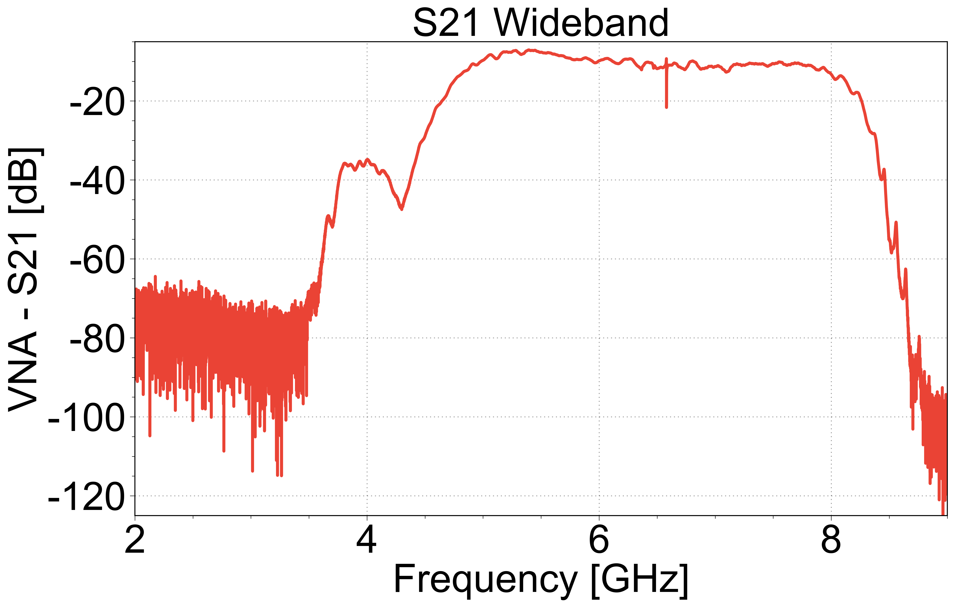
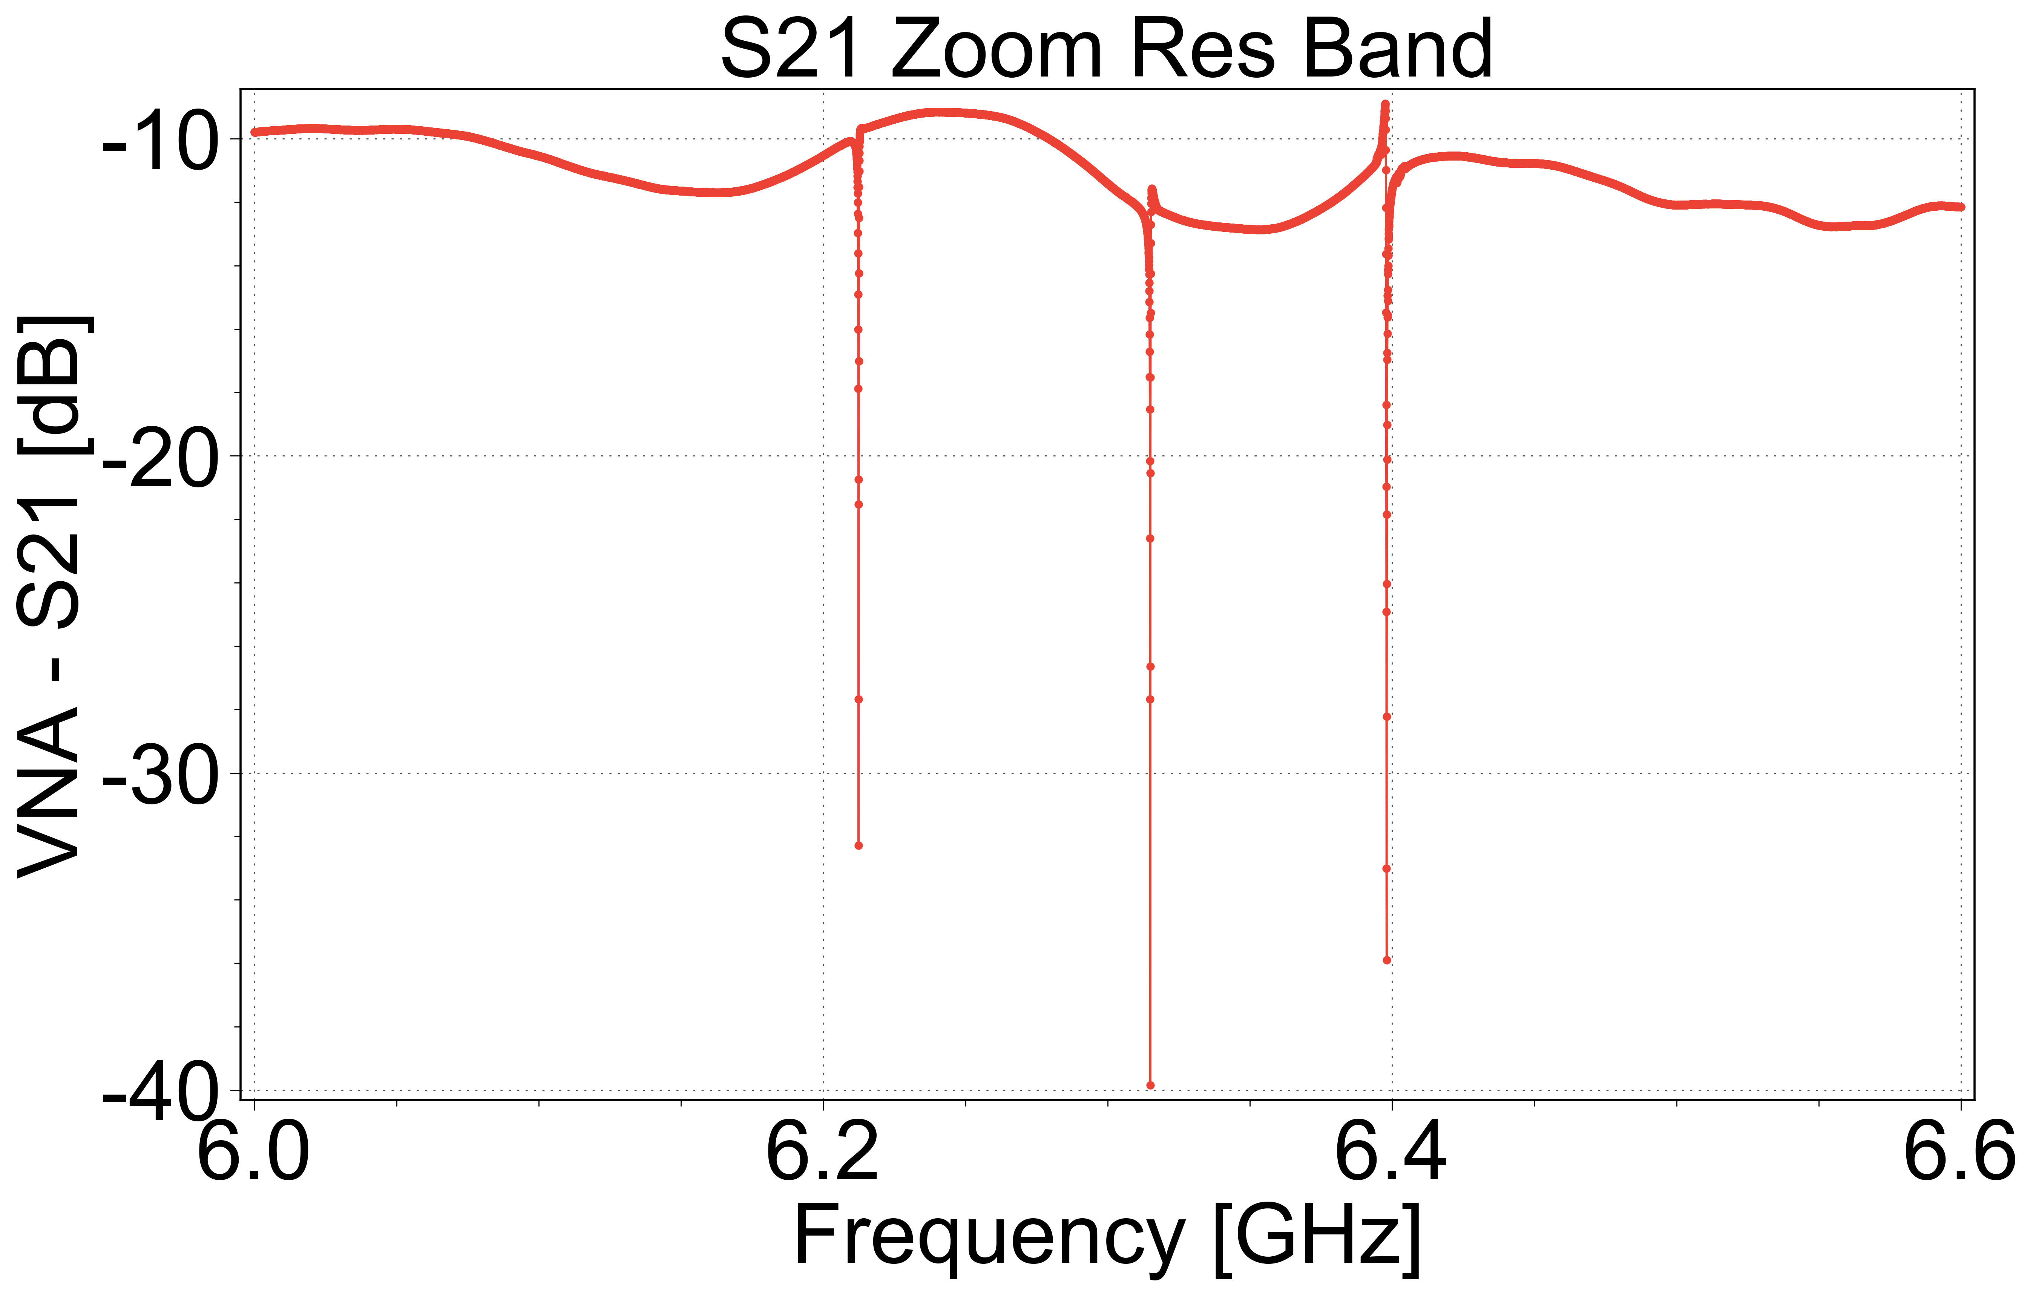
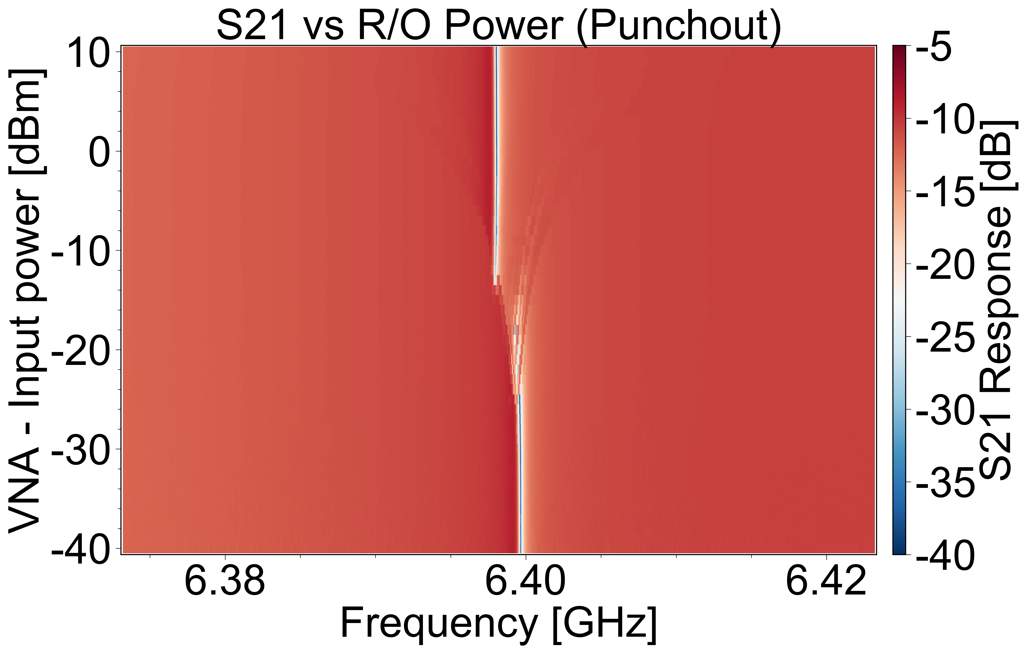
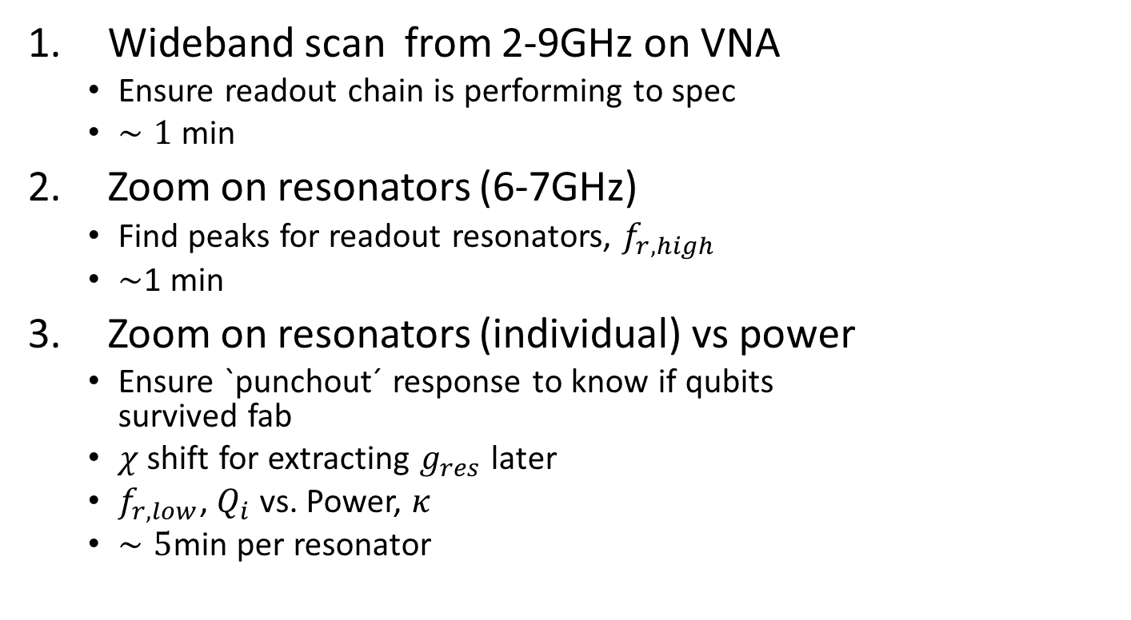
Resonator Spectroscopy
Wideband scan from 2-9GHz on VNA
Ensure readout chain is performing to spec
$∼1$ min
Zoom on resonators (6-7GHz)
Find peaks for readout resonators, $f_{r,high}$
$∼$1 min
Zoom on resonators (individual) vs power
Ensure `punchout´ response to know if qubits survived fab
$χ$ shift for extracting $g_{res}$ later
$f_{r,low}$, $Q_{i}$ vs. Power, $κ$
$∼5$min per resonator

Slide 3
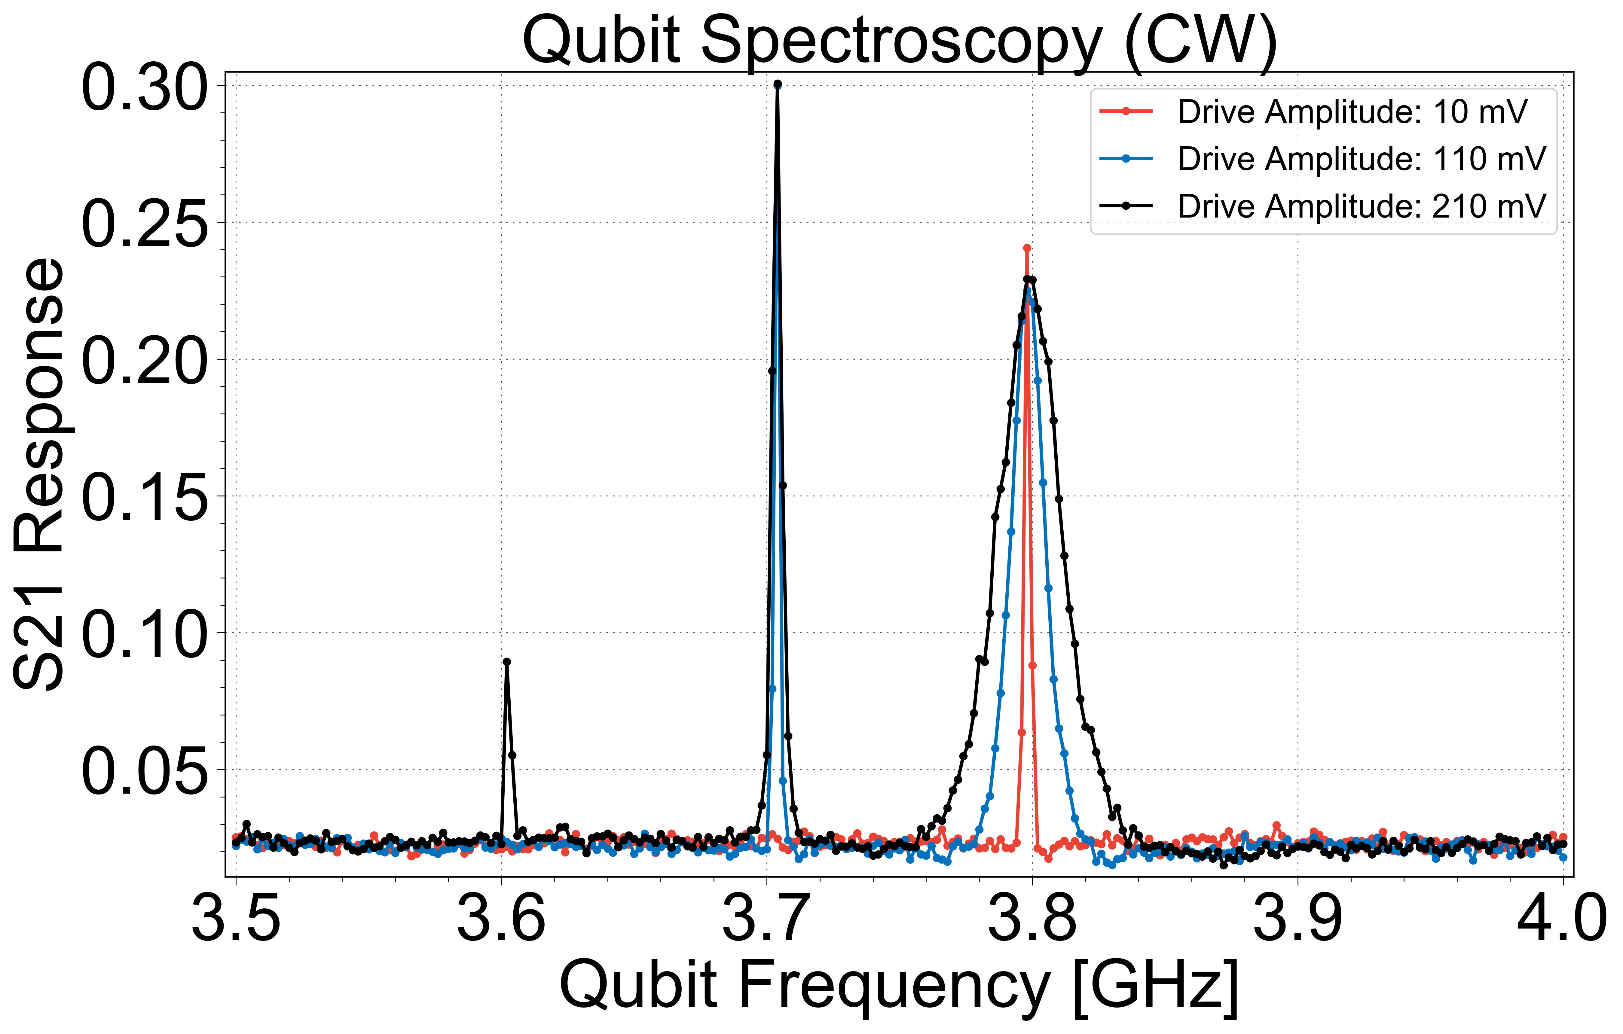
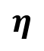
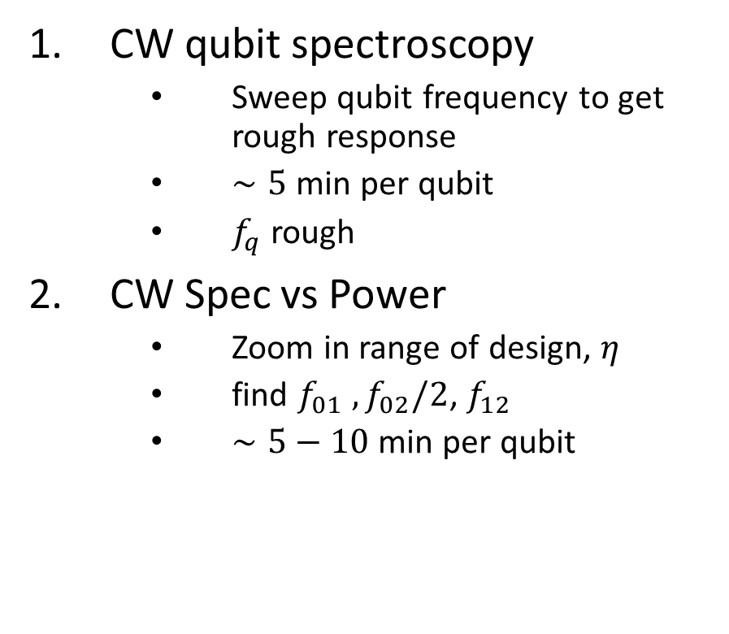
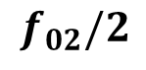
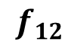
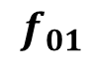
Qubit Spectroscopy (Rough)
CW qubit spectroscopy
Sweep qubit frequency to get rough response
$∼5$ min per qubit
$f_{q}$ rough
CW Spec vs Power
Zoom in range of design, $η$
find $f_{01} ,f_{02}/2$, $f_{12}$
$∼5−10$ min per qubit
$$f_{02}/2$$
$$f_{01}$$
$$f_{12}$$
$$η$$

Slide 4
Pulsed Spectroscopy

Slide 5
Resonator Spectroscopy (Pulsed)
Use previous information to guide initial frequency guesses
Can now perform multiplexed readout of the signals and read all resonators at once

Slide 6
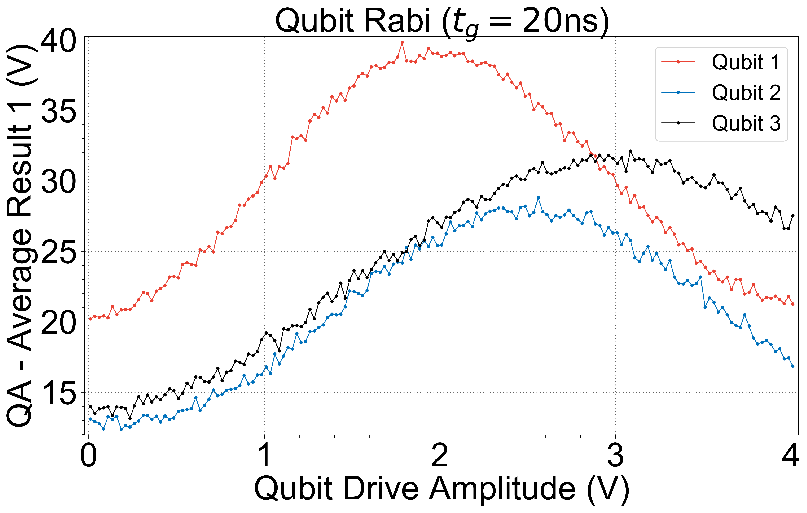
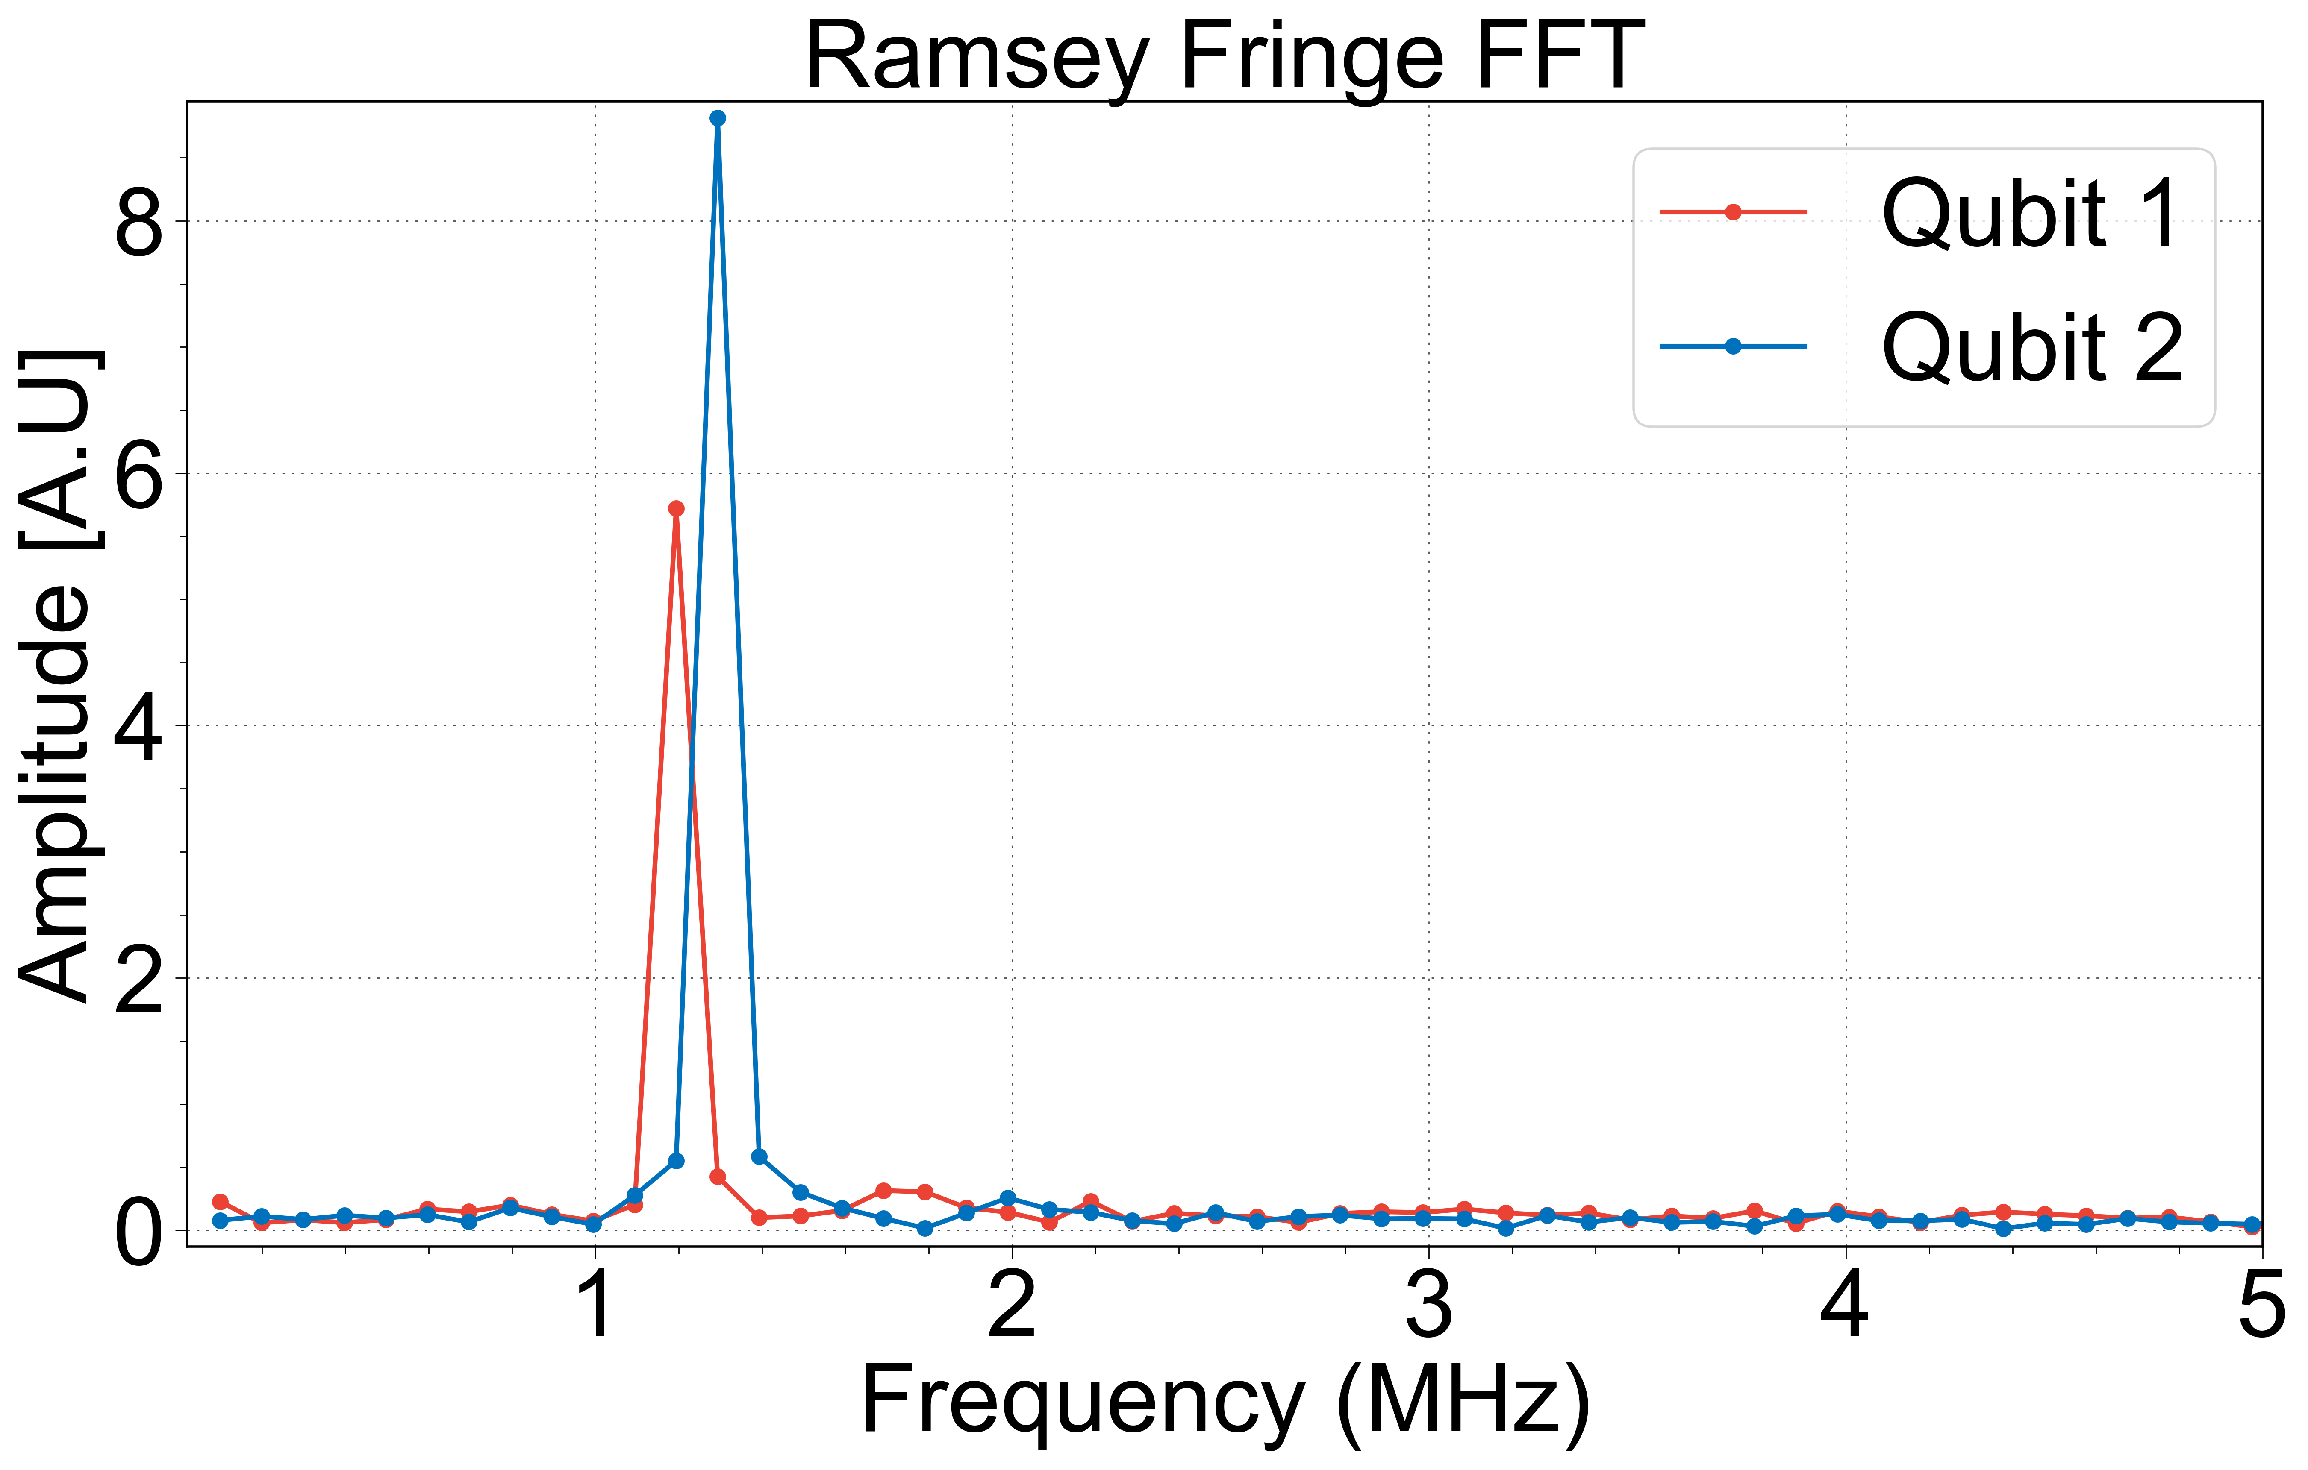
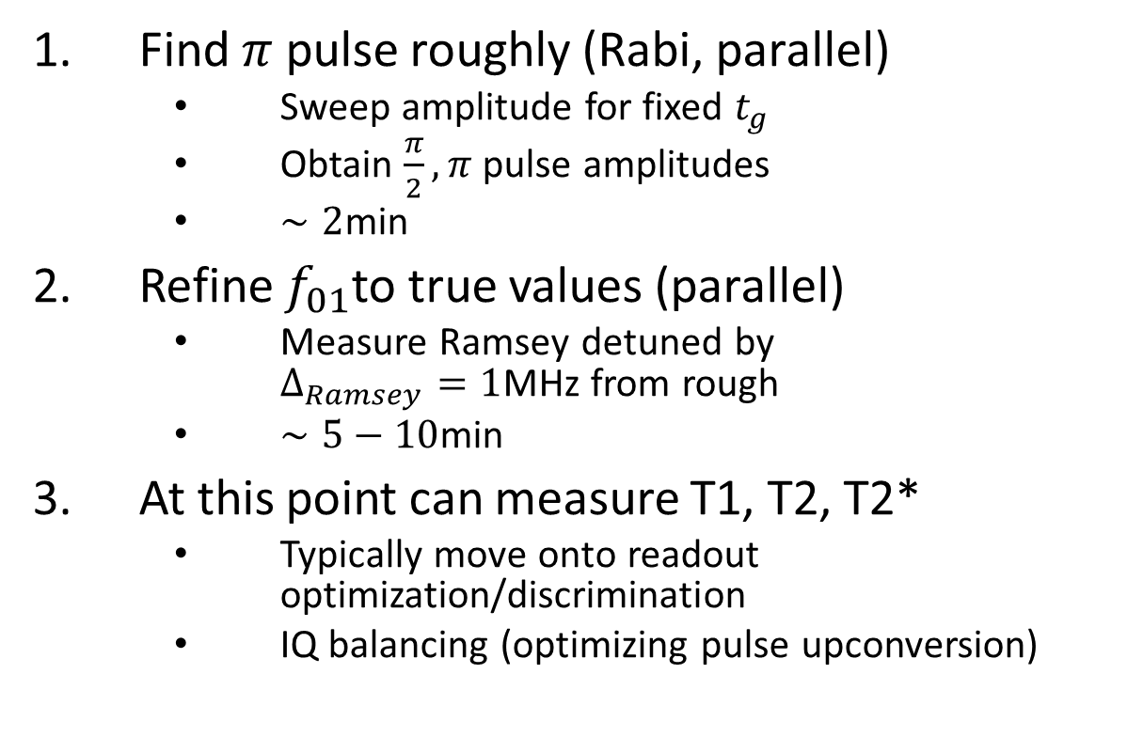
Single Qubit Control (Rough)
Find $π$ pulse roughly (Rabi, parallel)
Sweep amplitude for fixed $t_{g}$
Obtain $\frac{π}{2}, π$ pulse amplitudes
$∼2$min
Refine $f_{01}$to true values (parallel)
Measure Ramsey detuned by $Δ_{Ramsey}=1$MHz from rough
$∼5−10$min
At this point can measure T1, T2, T2*
Typically move onto readout optimization/discrimination
IQ balancing (optimizing pulse upconversion)

Slide 7
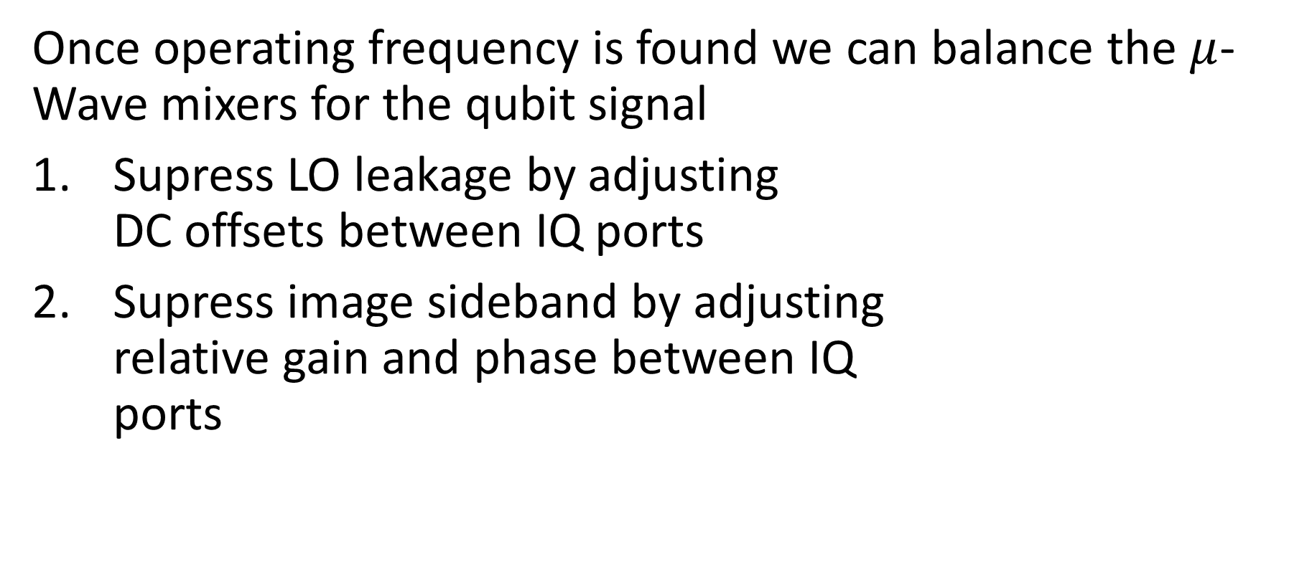
Mixer Calibration
Once operating frequency is found we can balance the $μ$-Wave mixers for the qubit signal
Supress LO leakage by adjusting DC offsets between IQ ports
Supress image sideband by adjusting relative gain and phase between IQ ports

Slide 8
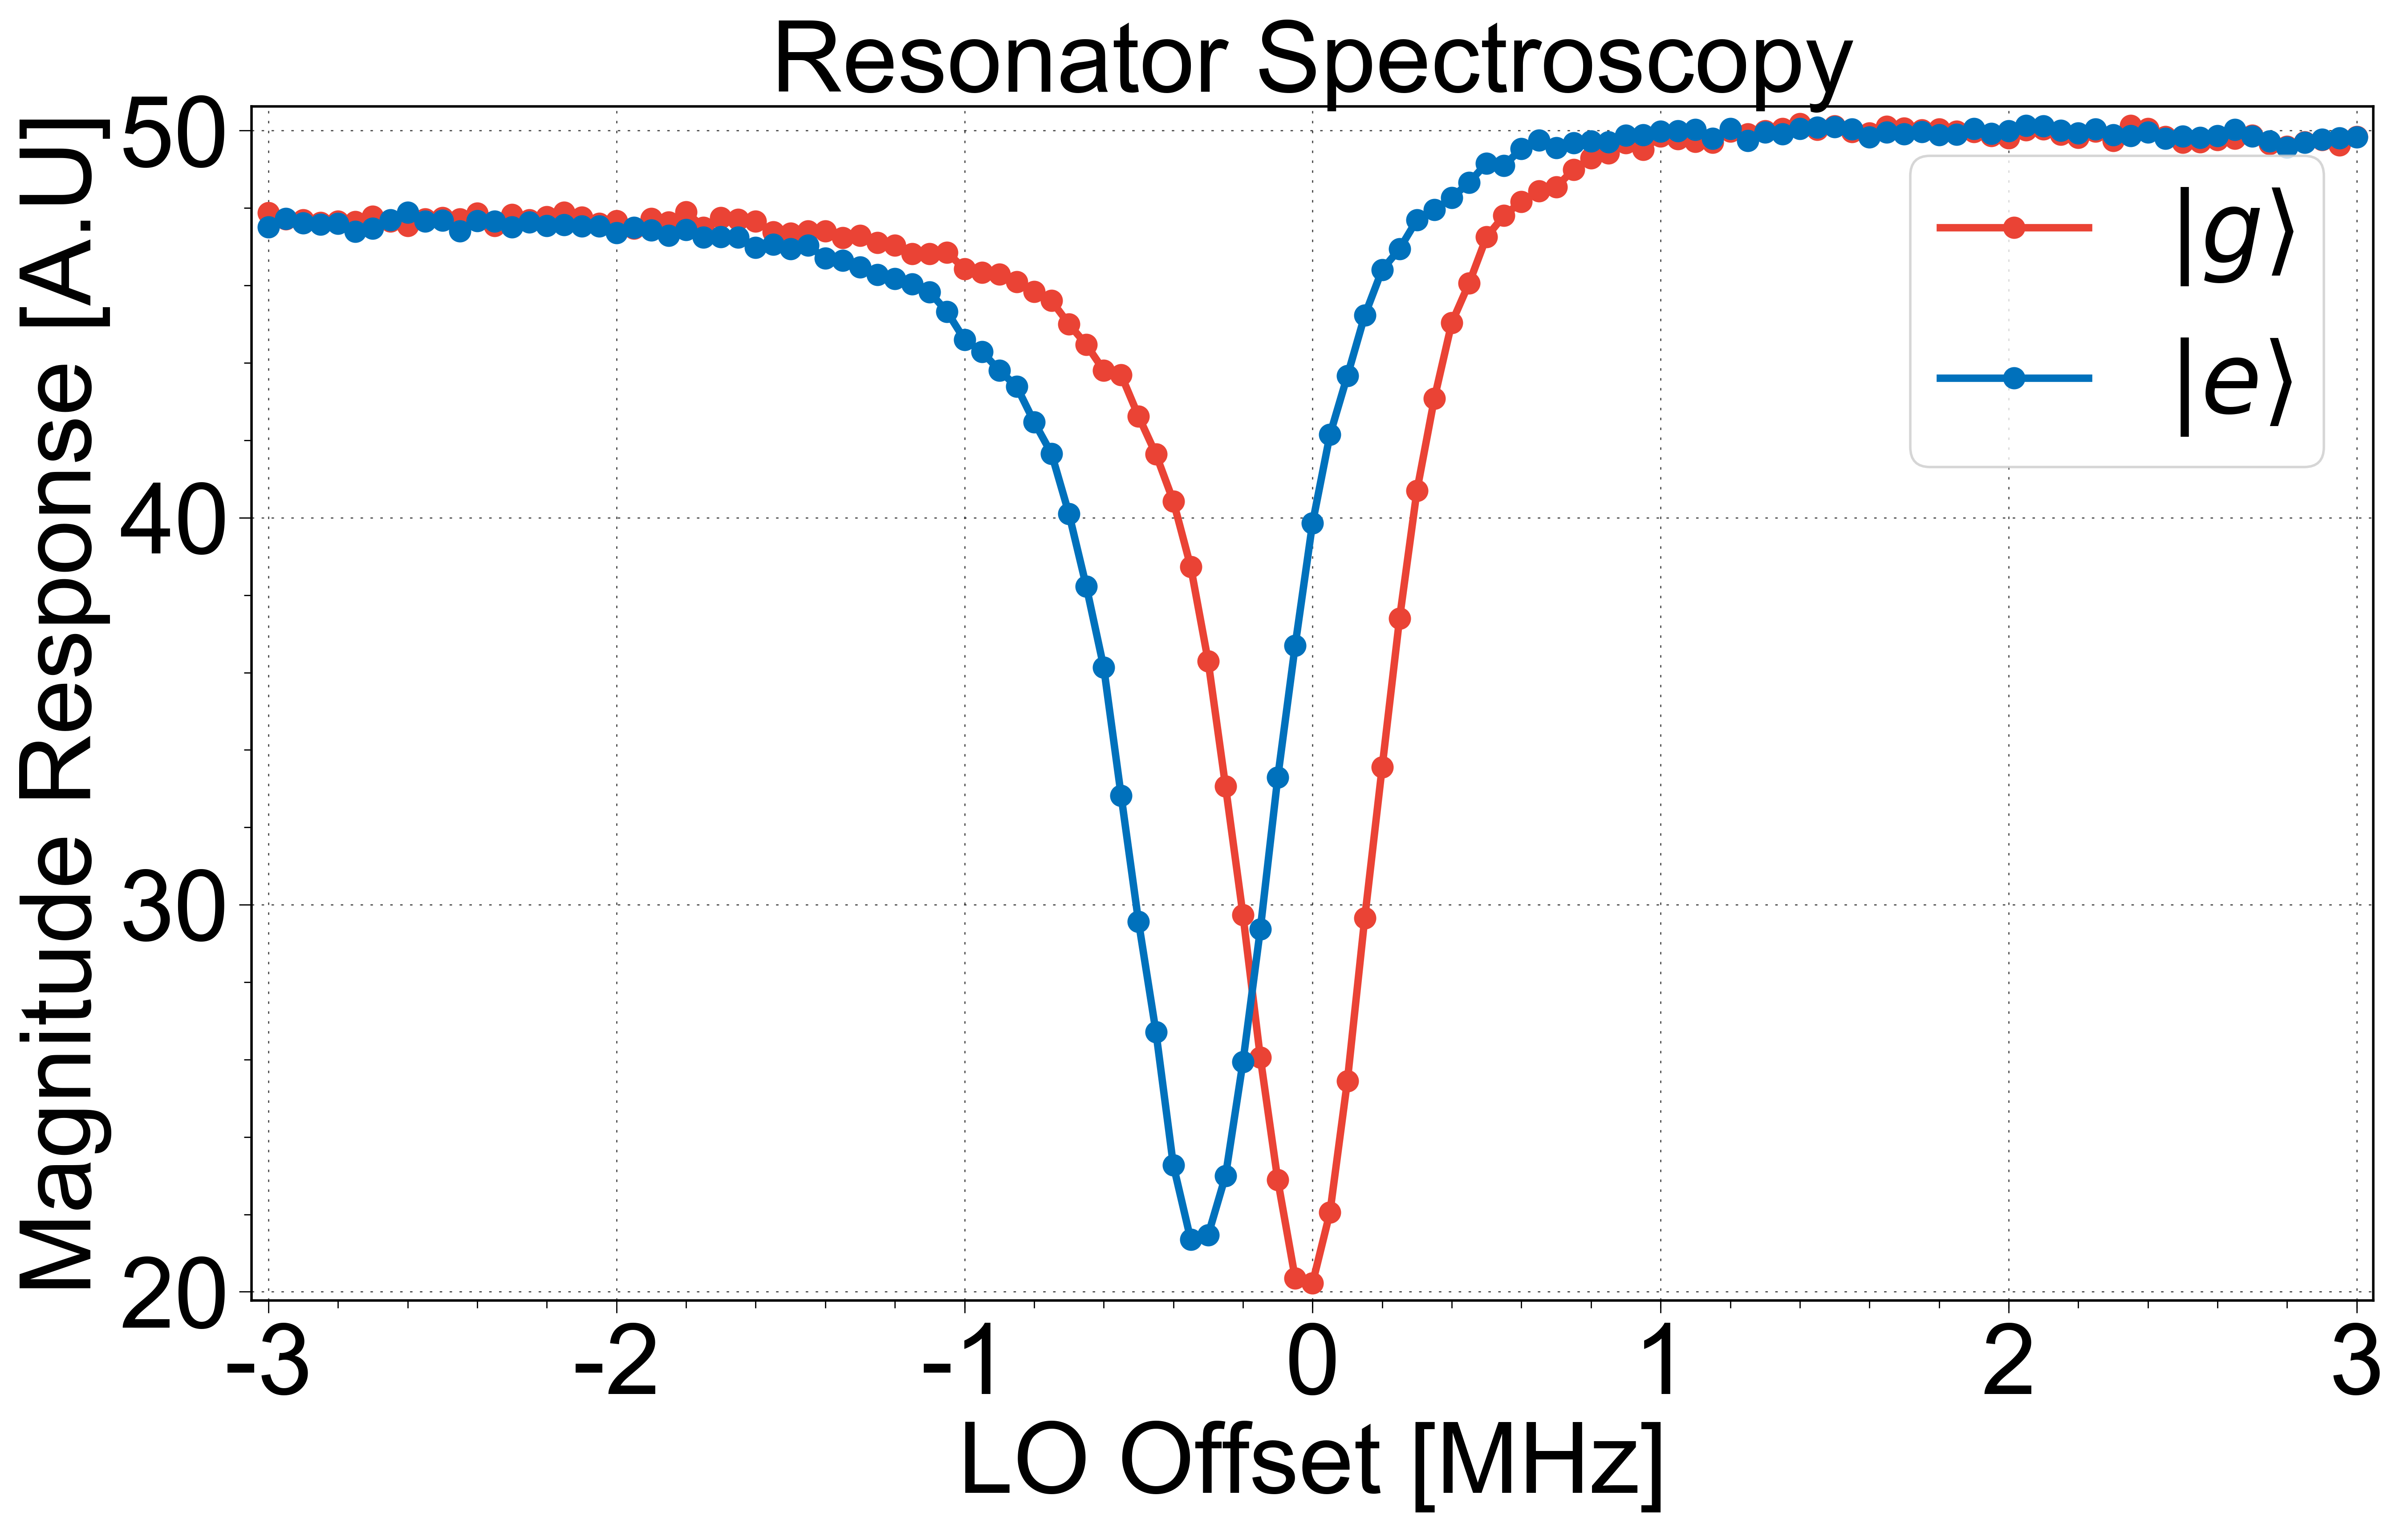
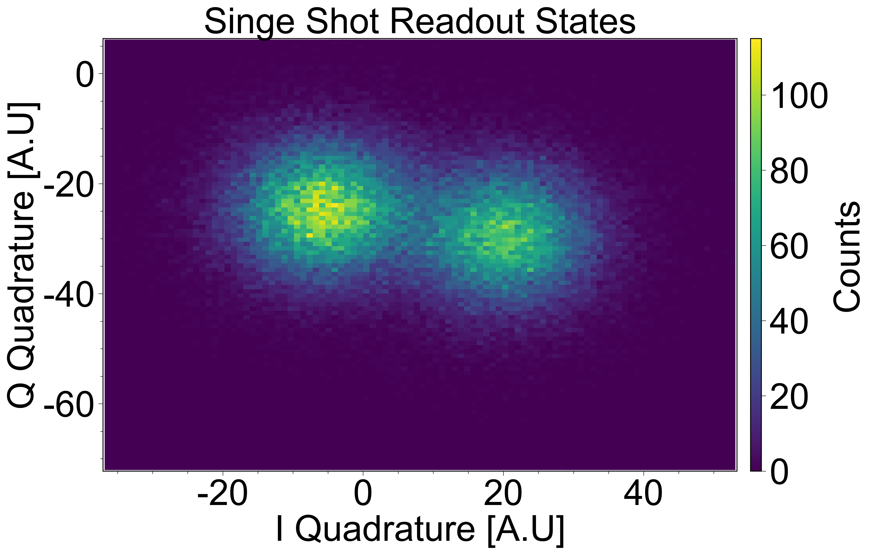
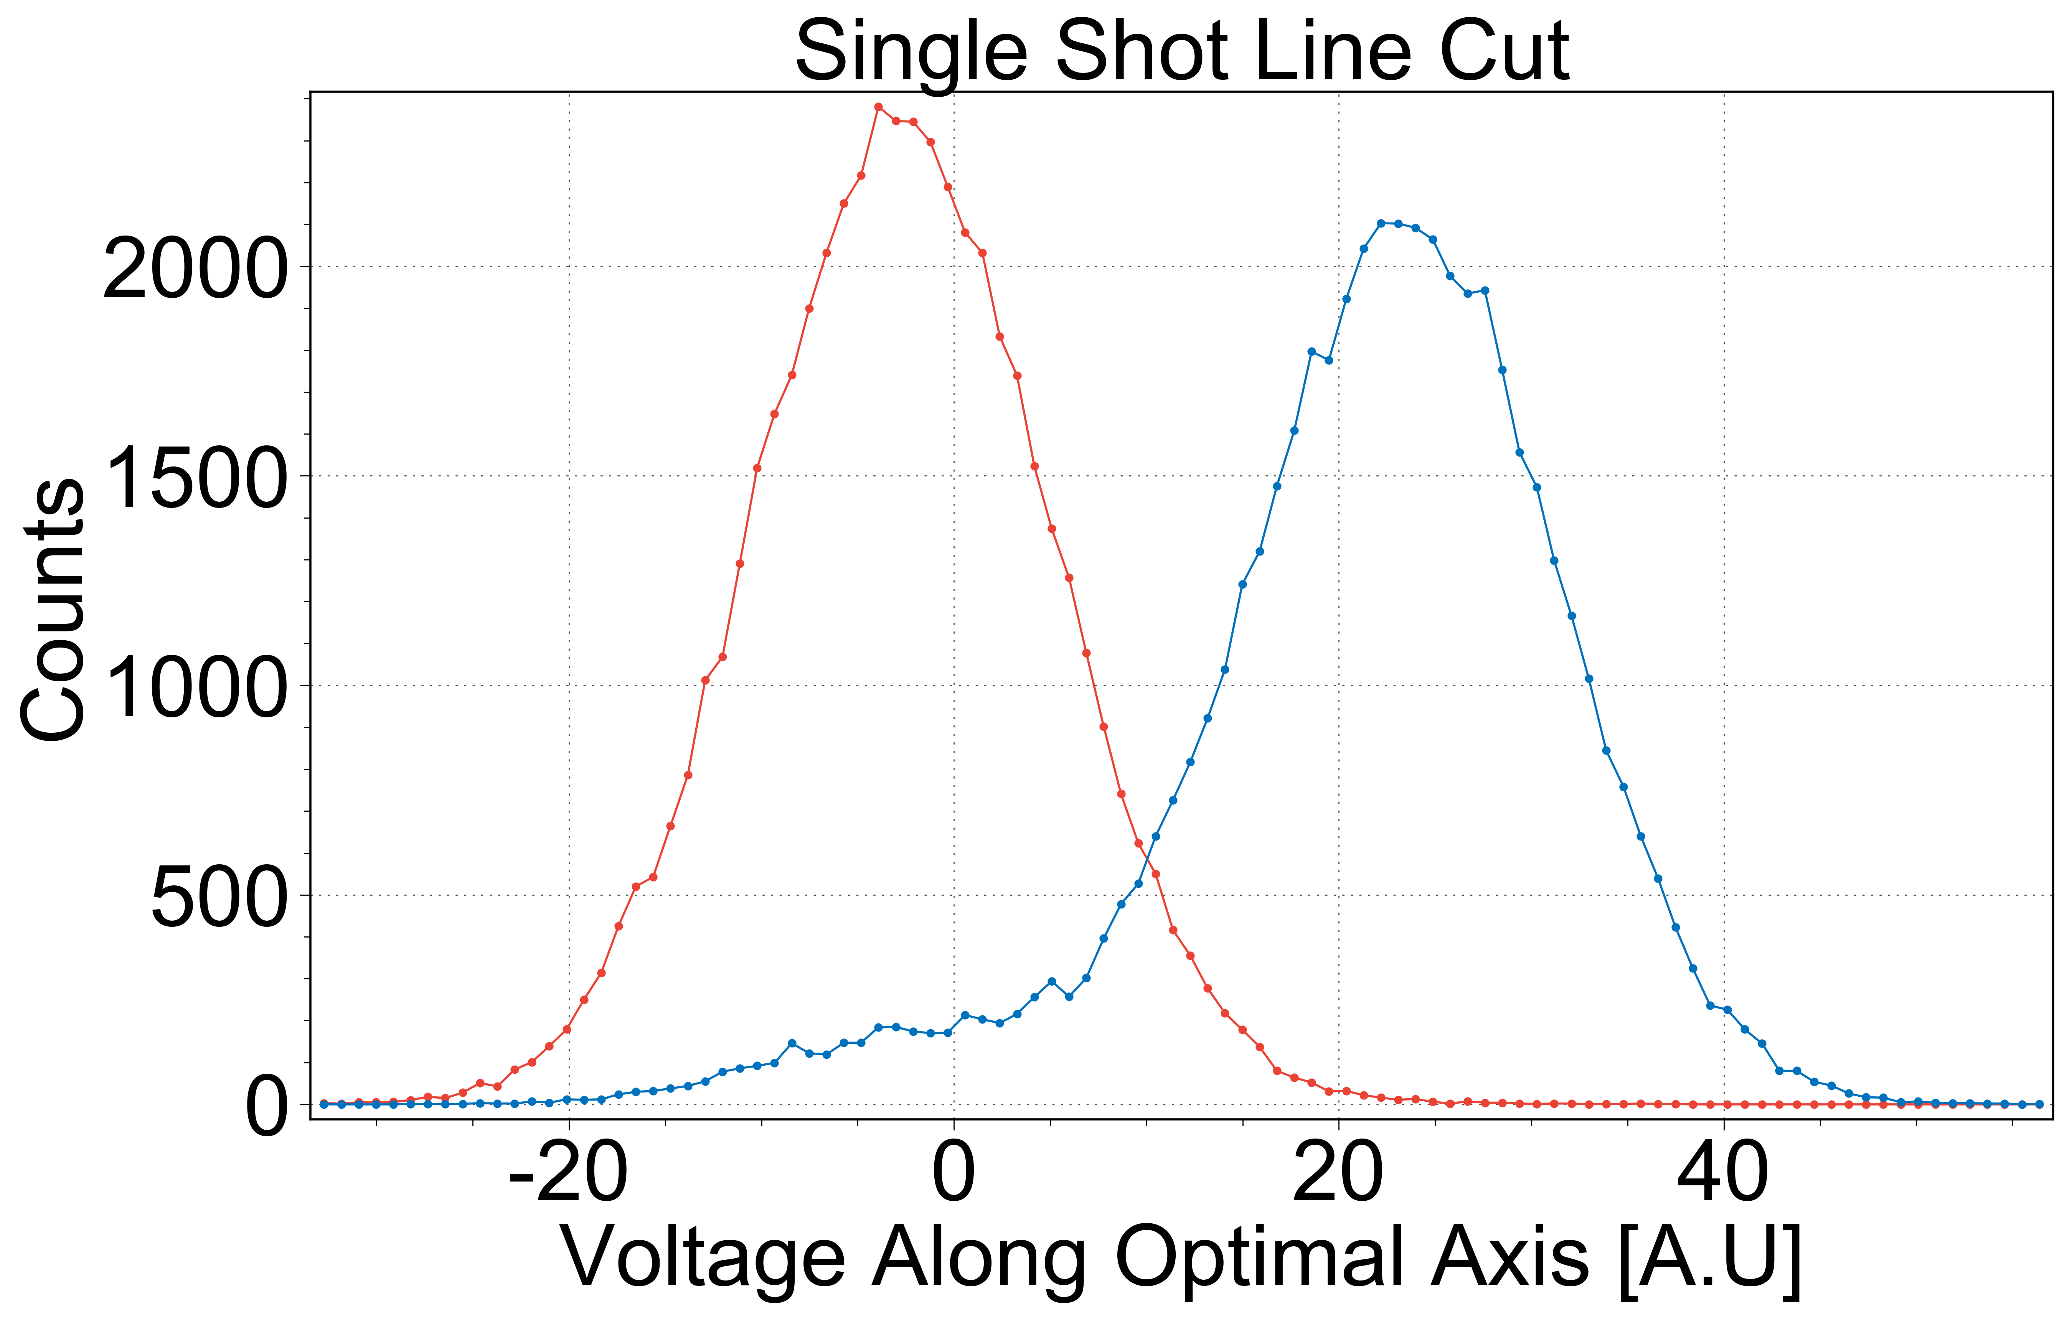

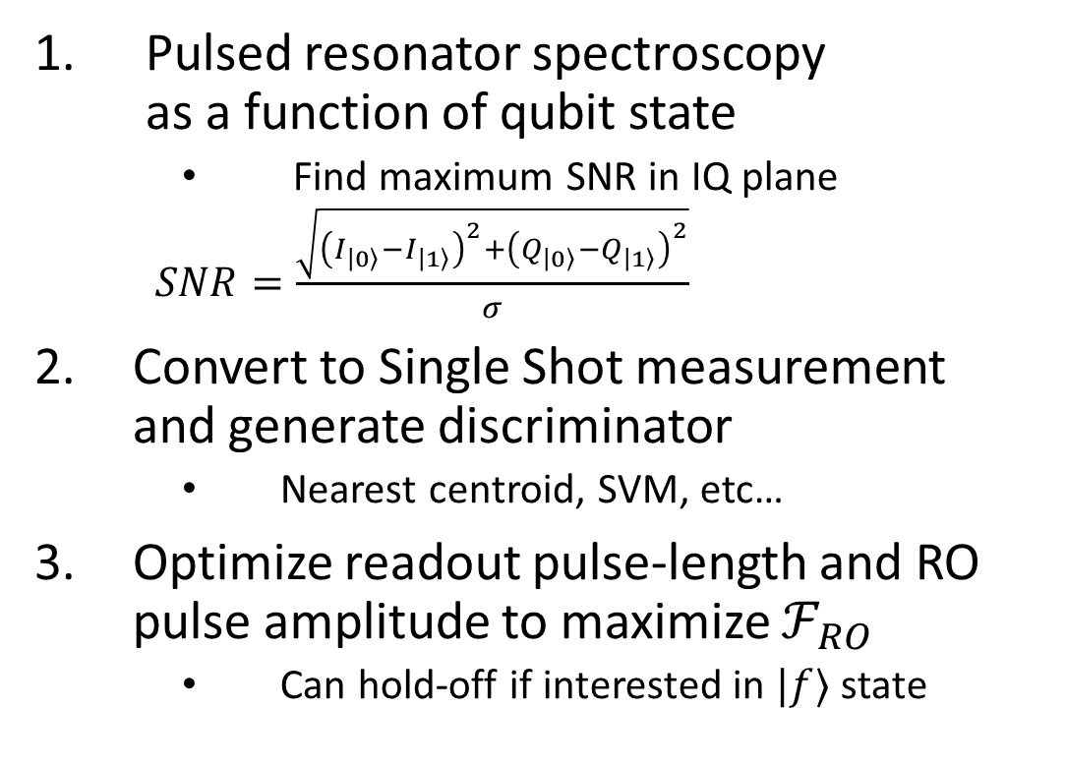

Readout Optimization (Round 1)
Pulsed resonator spectroscopy as a function of qubit state
Find maximum SNR in IQ plane
$SNR=\frac{\sqrt{{\left(I_{\left|0\right\rangle }−I_{\left|1\right\rangle }\right)}^{2}+{\left(Q_{\left|0\right\rangle }−Q_{\left|1\right\rangle }\right)}^{2}}}{σ}$
Convert to Single Shot measurement and generate discriminator
Nearest centroid, SVM, etc…
Optimize readout pulse-length and RO pulse amplitude to maximize $ℱ_{RO}$
Can hold-off if interested in $|f⟩$ state
$$|g⟩$$
$$|e⟩$$

Slide 9
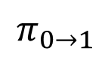
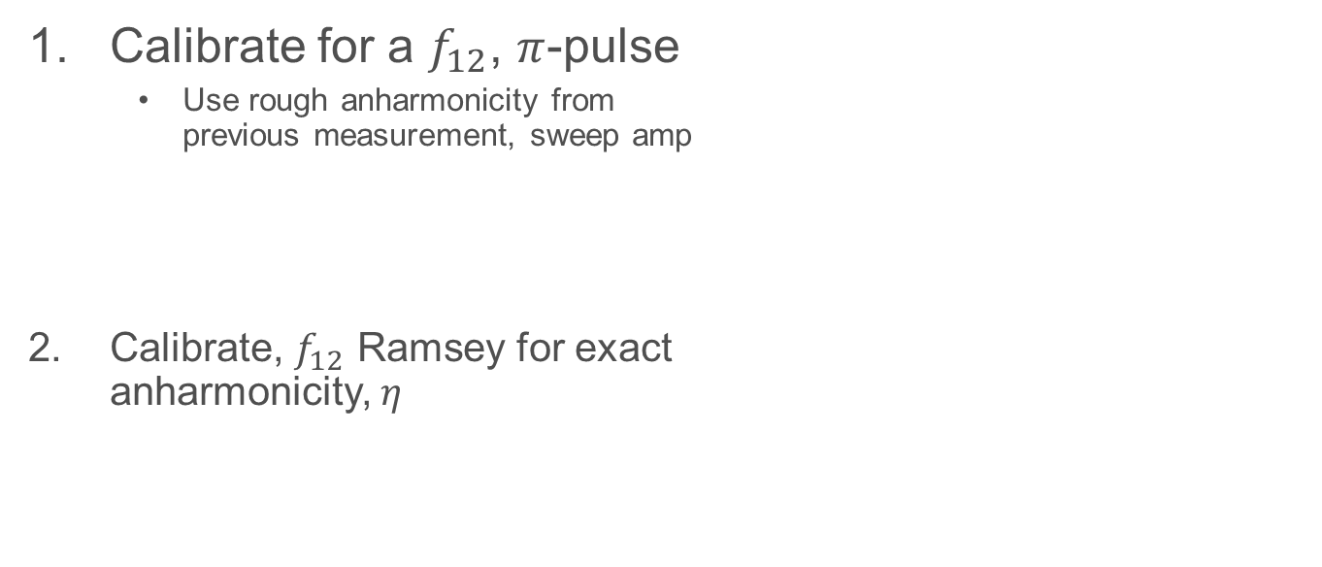
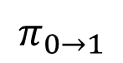
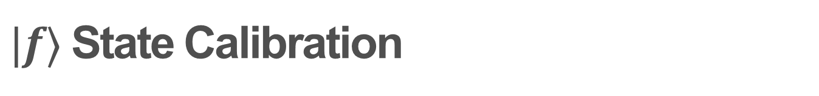
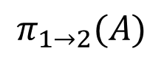
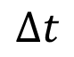
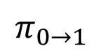
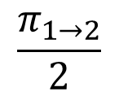
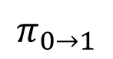
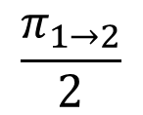
$|f⟩$ State Calibration
Calibrate for a $f_{12}$, $π$-pulse
Use rough anharmonicity from previous measurement, sweep amp
Calibrate, $f_{12}$ Ramsey for exact anharmonicity, $η$
$$π_{0→1}$$
$$π_{1→2}(A)$$
$$π_{0→1}$$
$$\frac{π_{1→2}}{2}$$
$$Δt$$
$$\frac{π_{1→2}}{2}$$
$$π_{0→1}$$
$$π_{0→1}$$

Slide 10
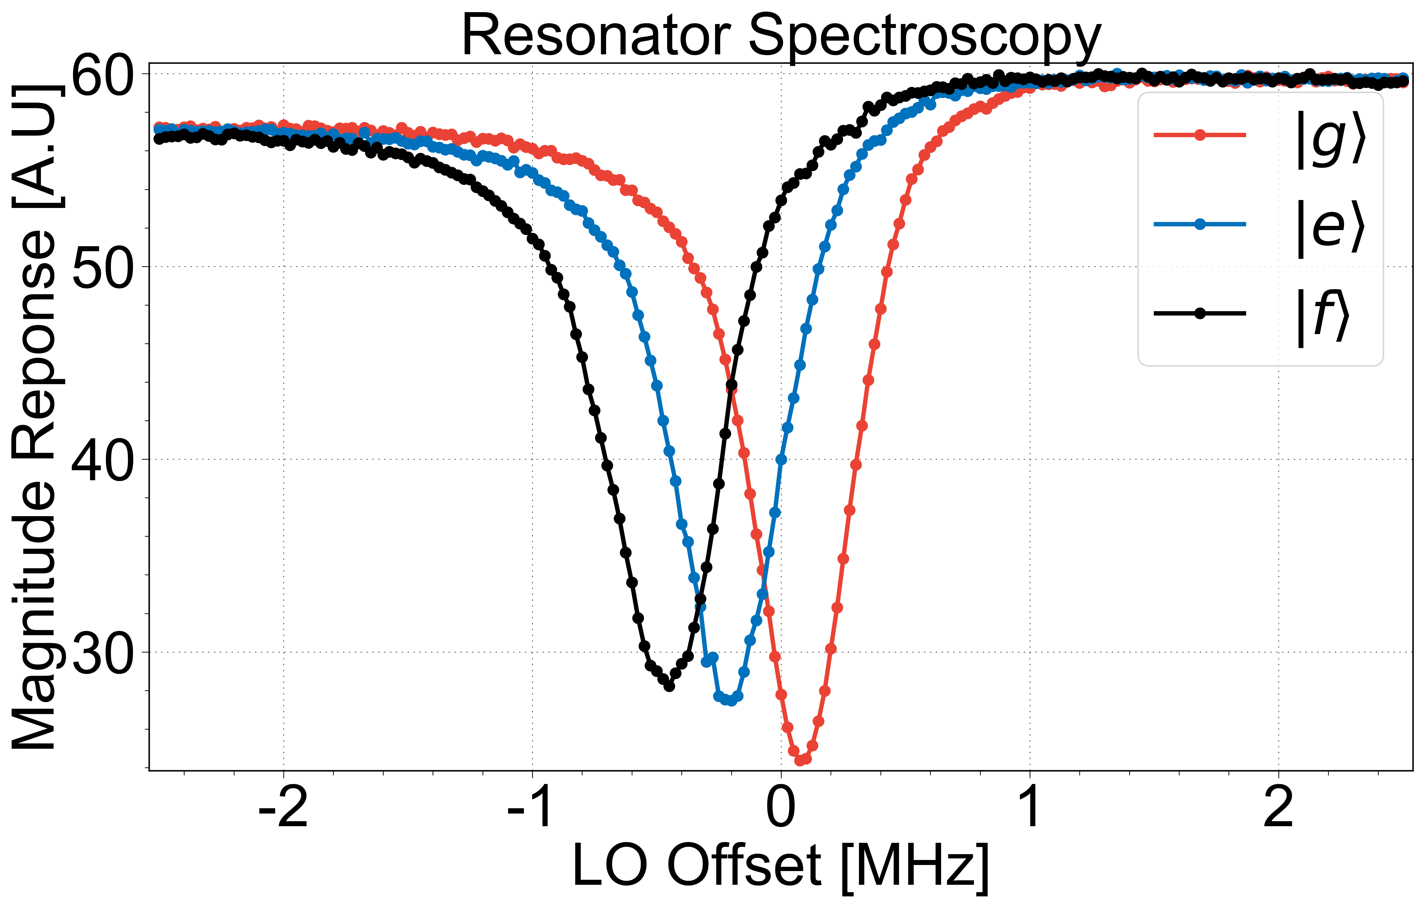
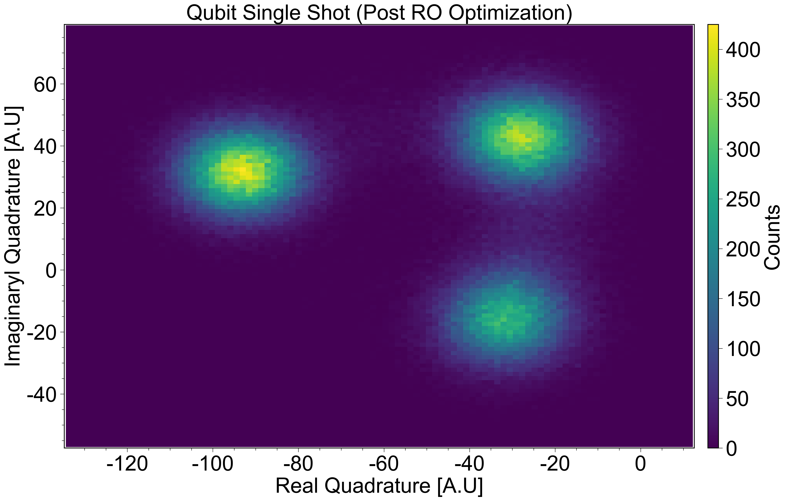
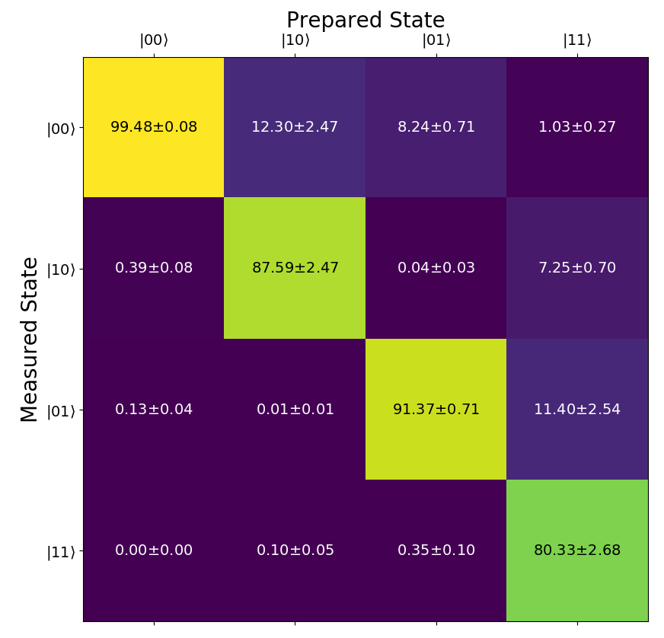
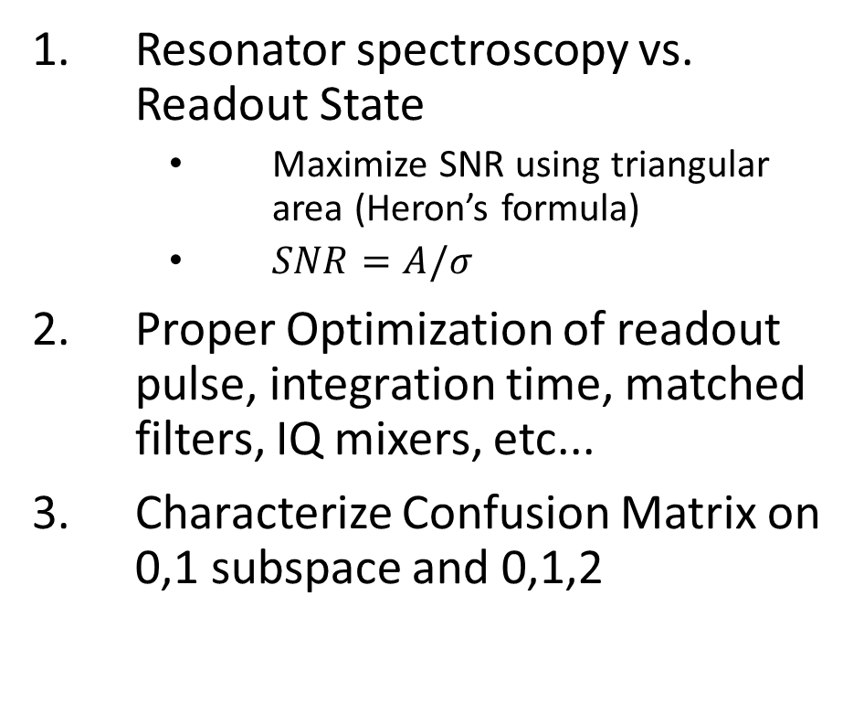
Readout Optimization (Round 2)
Resonator spectroscopy vs. Readout State
Maximize SNR using triangular area (Heron’s formula)
$SNR=A/σ$
Proper Optimization of readout pulse, integration time, matched filters, IQ mixers, etc...
Characterize Confusion Matrix on 0,1 subspace and 0,1,2

Slide 11
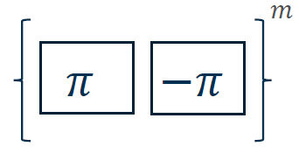
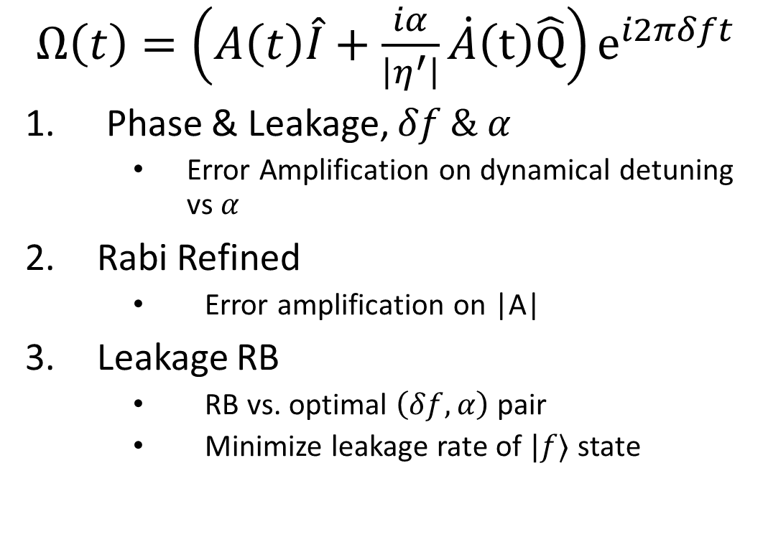
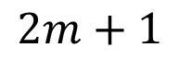
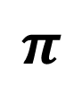
DRAG Optimization
$Ω\left(t\right)=\left(A\left(t\right)\hat{I}+\frac{iα}{\left|η^{′}\right|}\dot{A}\left(t\right)\hat{Q}\right)e^{i2πδft}$
Phase & Leakage, $δf \& α$
Error Amplification on dynamical detuning vs $α$
Rabi Refined
Error amplification on |A|
Leakage RB
RB vs. optimal $\left(δf, α\right)$ pair
Minimize leakage rate of $|f⟩$ state
$$2m+1$$
$$π$$

Slide 12
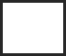
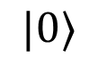

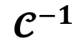
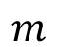
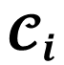
Verification of Performance (RB)
Want to quantify the errors associated with our tuned up gates
Apply a protocol called Randomized Benchmarking (RB)
Finds us the average error per 1-Qubit operation
Randomly select a sequence of gates of depth, m
Find the gate which inverts the m-depth sequence
Repeat this k times and average the results
Fit the average decay and extract the error per gate
$$m$$
$$|0⟩$$
$$𝓒_{i}$$
$$𝓒^{−1}$$

Slide 13
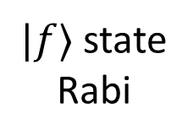
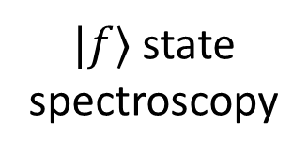
Readout
Parallelized
Calibration Flow Outline
Single Qubit
Not Parallelized
Manually Disconnect VNA
$|f⟩$ state spectroscopy
$|f⟩$ state Rabi
Refined Driving Amplitude
CW Qubit Spectroscopy
Connect to Spectrum Analyzer IQ Balancing
Rabi Driving
DRAG Calibration
Resonator Zoom
Ramsey Driving
Single Qubit RB
Resonator Wide
Qubit Punchout
Pulsed Readout Spectroscopy
Readout Optimization g-e
Connect to Spectrum Analyzer
Single Shot/ State Discrimination
Readout Optimization g-e-f

Slide 14
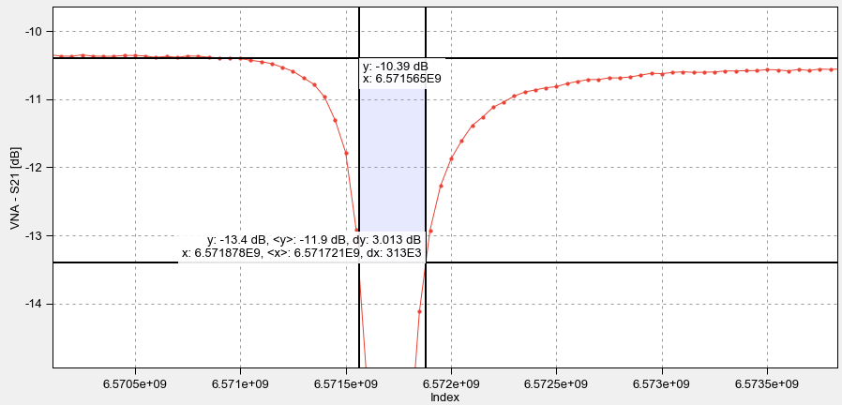

Slide 15
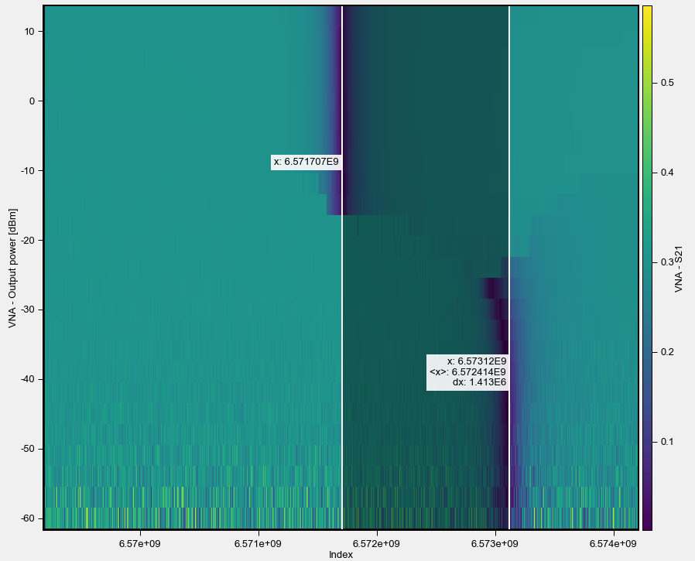

Slide 16
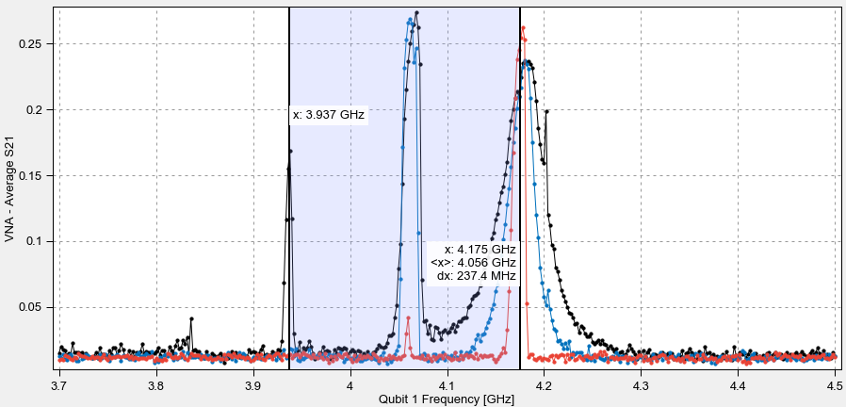

Slide 17
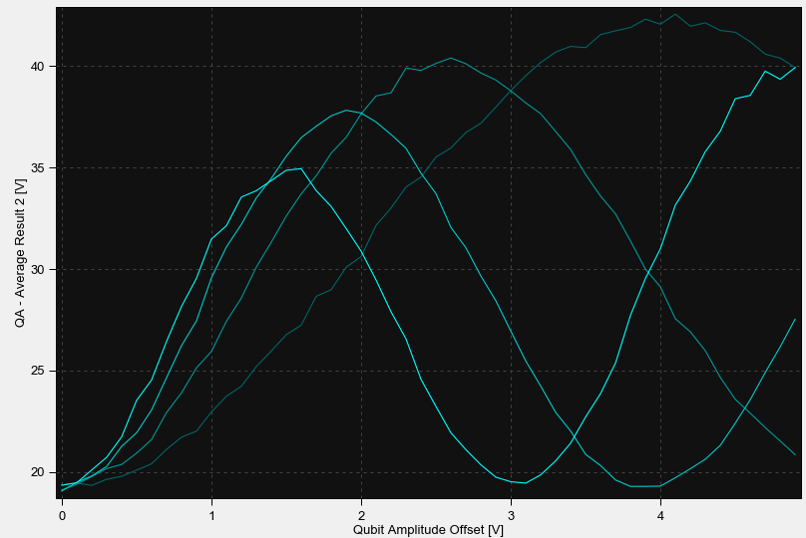

Slide 18
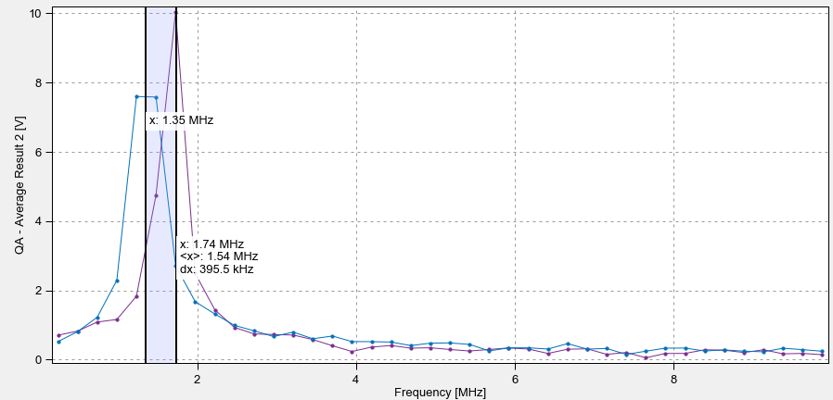

Slide 19
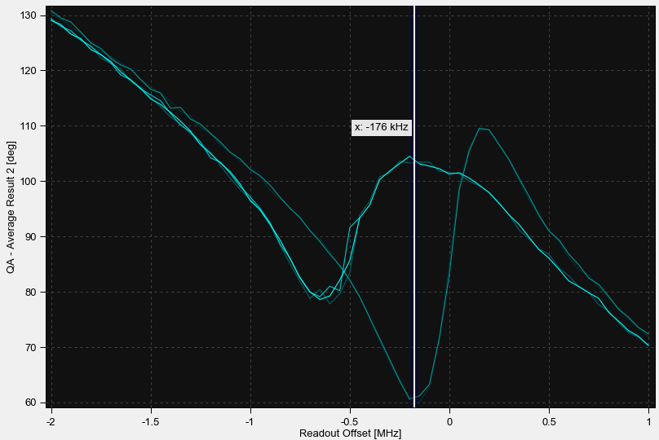

Slide 20
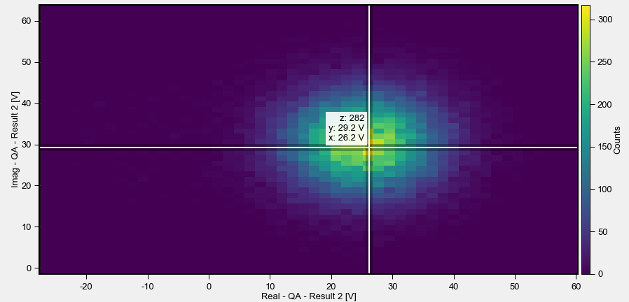



Slide 21


Slide 22


Slide 23


